Slide 1
Technin 510 Week 7
Connected Devices
11/10/21

Slide 2
Today
Connected Devices
Movement
Touch
Camera
Orientation
Geolocation
Lunch
Technin510 L7 Connected Devices

Slide 3
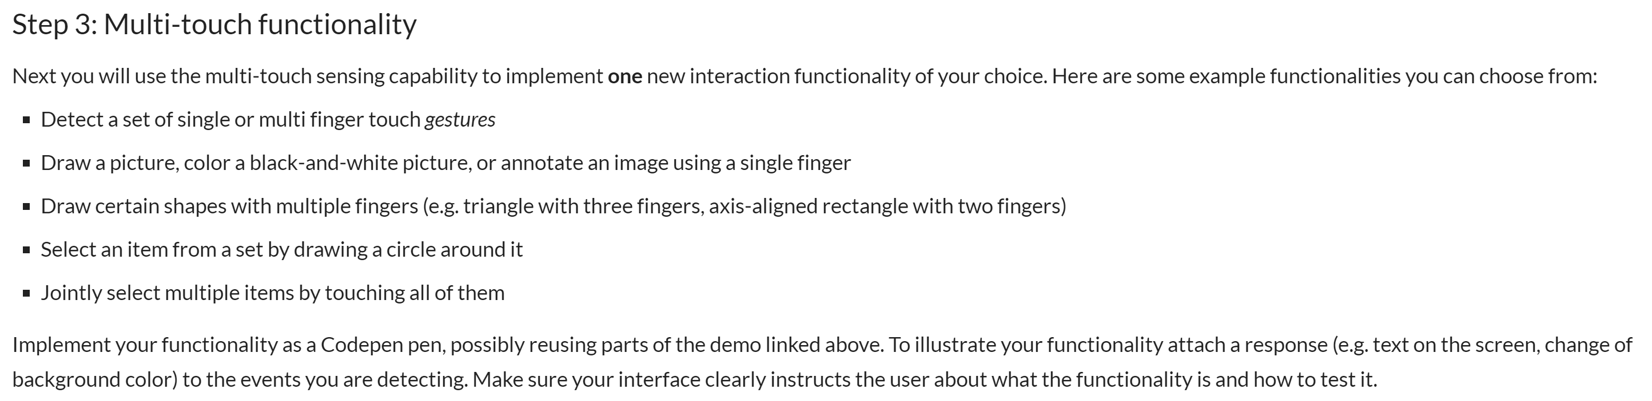
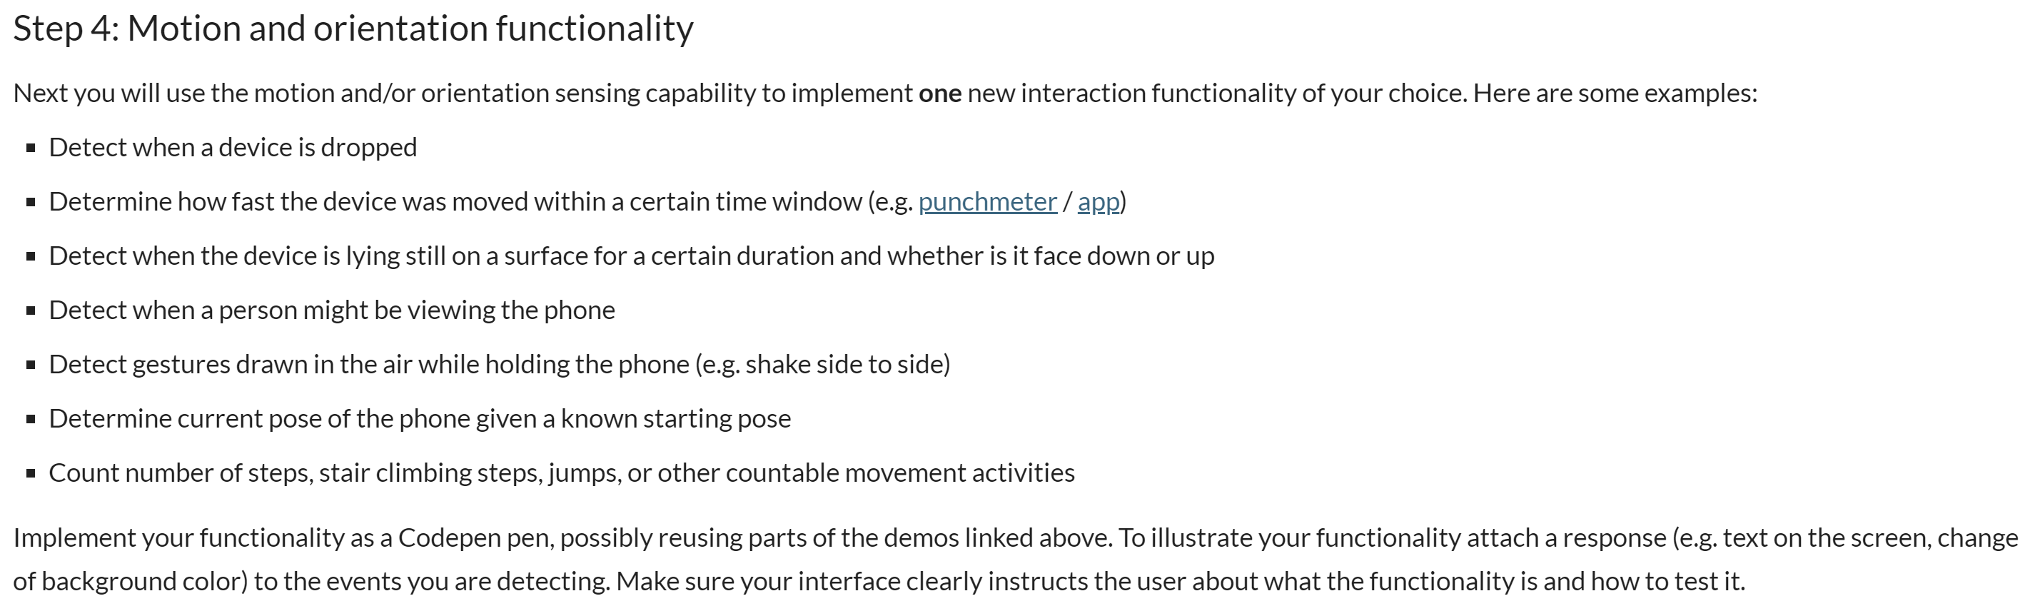
Today’s In-Class Exercises
Drawing a picture with Touch
Step Counter + Python Server

Slide 4
Sensors
Lecture 7 Workbook
Think of your hardware platform (smartphone, tablet, laptop, desktop)
Think of the output data format
gyroscope/accelerometer: alpha,beta,gamma / x,y,z
touchscreen: x,y
camera: r,g,b over x,y
And all of these can have a time dimension as well (up to us whether we want to analyze as a snapshot in time or not)

Slide 5
Accelerometer
New vocab…
window.DeviceMotionEvent;
window.addEventListener("devicemotion“);
…
event.acceleration.x; // .y .z
event.accelerationIncludingGravity.x; // .y .z

Slide 6

Gyroscope
New vocab…
window.DeviceMotionEvent;
window.addEventListener("devicemotion“);
…
event.rotationRate.alpha; // .beta .gamma
In the Lecture 7 workbook
Make sure the motion sensors register on your device
In addition to the accelerometer data being displayed on the webpage,
Display the gyroscope (rotation rate) data to the webpage

Slide 7
Touch
The changedTouches read-only property is a TouchList whose touch points (Touch objects) varies depending on the event type, as follows:
For the touchstart event, it is a list of the touch points that became active with the current event.
For the touchmove event, it is a list of the touch points that have changed since the last event.
For the touchend event, it is a list of the touch points that have been removed from the surface (that is, the set of touch points corresponding to fingers no longer touching the surface).
In the Lecture 7 workbook
Instead of displaying black circles on the webpage canvas, display blue squares

Slide 8
Camera
New vocab…
navigator.mediaDevices.getUserMedia({video: true})
…
video = document.getElementById('my_video');
video.style.width = document.width + 'px';
video.style.height = document.height + 'px';
video.setAttribute('playsinline', '');
requests permission to use a media input which produces a MediaStream with tracks containing the requested types of media (video)
plays video in video element instead of fullscreen. I needed this to work on iOS safari

Slide 9
Camera
New vocab…
var constraints = {
audio: false,
video: {
facingMode: 'user'
}
}
navigator.mediaDevices.getUserMedia(constraints).then(function success(stream) {
video.srcObject = stream;
Constrain media to just the front camera and no audio
sets the media source associated with the HTMLMediaElement

Slide 10
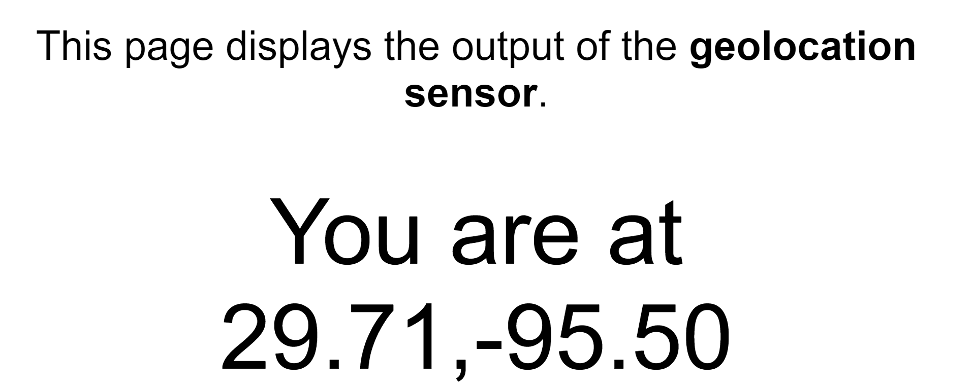
Geolocation
https://codepen.io/wesleybeckner/pen/ExyeeWP

Slide 11
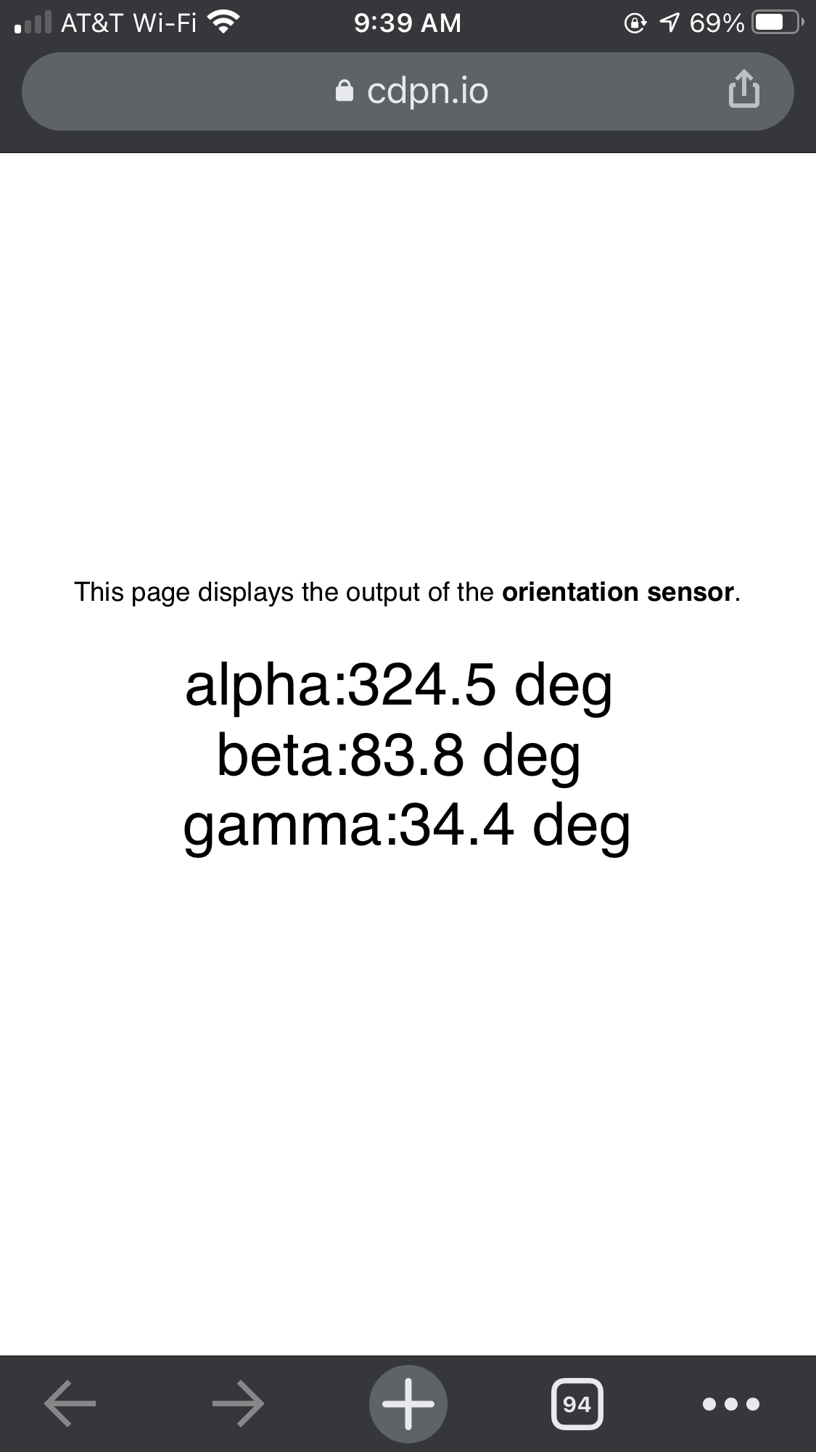
Orientation
https://codepen.io/wesleybeckner/pen/LYZJJxb

Slide 12
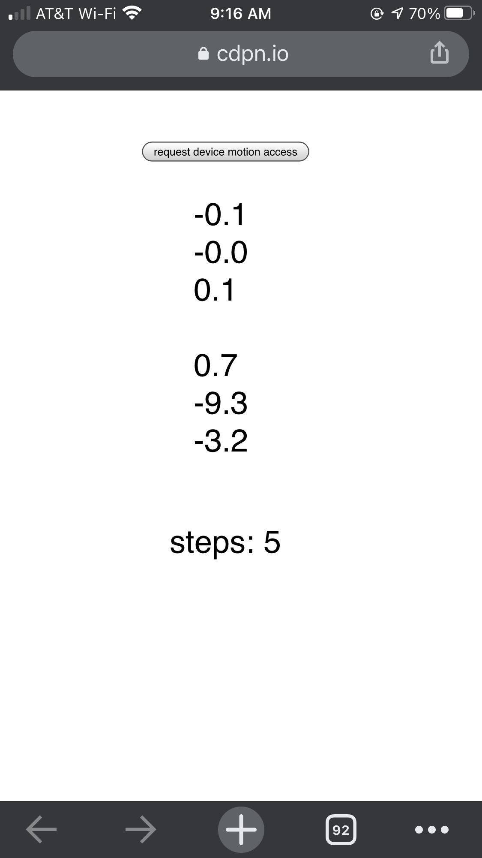
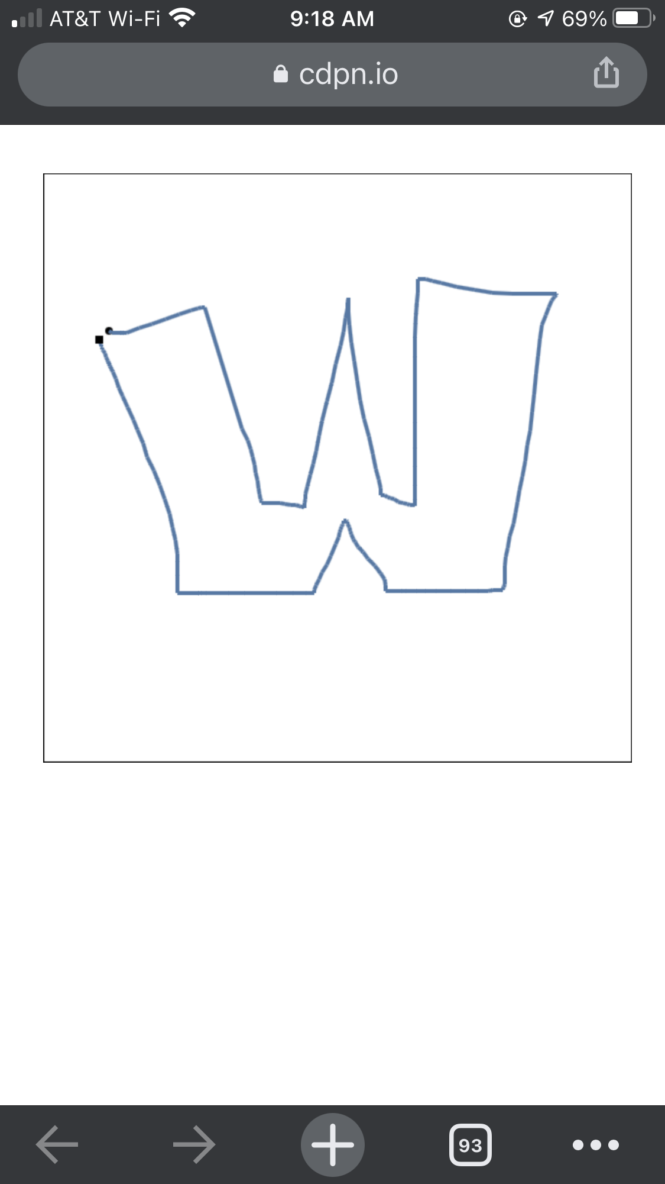
In-Class Exercises
Group 1: Touch
Add Feature: color palette
Group 2: Motion and Orientation
Fix Bug: orientation for step counting
Group 3: ✌️ work on my own thing
Hacking in groups 1 & 2:
Vote on agreed upon bug fix or feature addition for the basecode
Work on this independently or in sub groups as you wish
Upon achieving the hack goal share with rest of group (demo your code + walkthrough)
Can repeat!

